Slide 1

Quantifying the Link Player in Soccer: A Network and Spatial Analysis
Elliott Scott

Slide 2

What is the task?
Teams use passing to efficiently move the ball across the pitch.
Top players excel at creating goal-scoring opportunities through their passes.
This project aims to evaluate and measure each player’s effectiveness in contributing to these outcomes.
Develop a metric to quantify a player’s influence on passing structures that lead to goal-scoring opportunities.

Slide 3
What is the task?
Teams use passing to efficiently move the ball across the pitch.
Top players excel at creating goal-scoring opportunities through their passes.
This project aims to evaluate and measure each player’s effectiveness in contributing to these outcomes.
Develop a metric to quantify a player’s influence on passing structures that lead to goal-scoring opportunities.

Slide 4
What is the task?
Teams use passing to efficiently move the ball across the pitch.
Top players excel at creating goal-scoring opportunities through their passes.
This project aims to evaluate and measure each player’s effectiveness in contributing to these outcomes.
Develop a metric to quantify a player’s influence on passing structures that lead to goal-scoring opportunities.

Slide 5
What is the task?
Teams use passing to efficiently move the ball across the pitch.
Top players excel at creating goal-scoring opportunities through their passes.
This project aims to evaluate and measure each player’s effectiveness in contributing to these outcomes.
Develop a metric to quantify a player’s influence on passing structures that lead to goal-scoring opportunities.

Slide 6
Data Sources
Hudl Statsbomb
Event data (Passes, Shots, Goals)
360 tactical data (Locations of Players during Events)
All 34 of Bayer Leverkusen’s unbeaten league matches in 2023/24.
Roughly 3400 events per game.

Slide 7
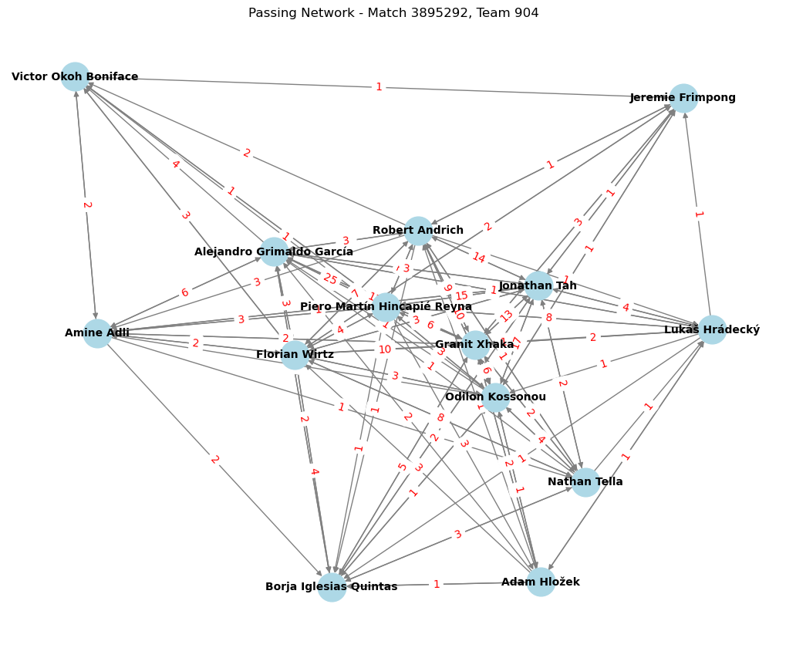
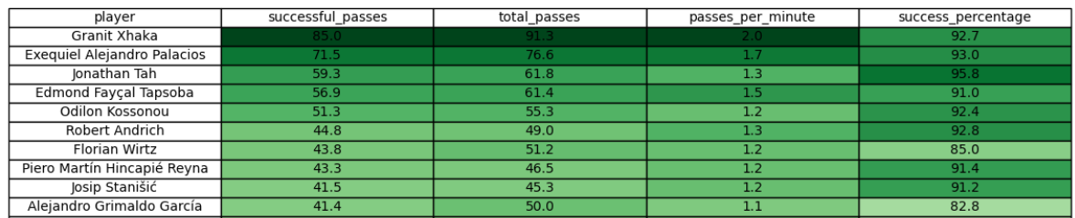
When is a player important to the passing structure?
They connect passes with many different teammates, making them central to the structure
High number of passes
High passing accuracy

Slide 8
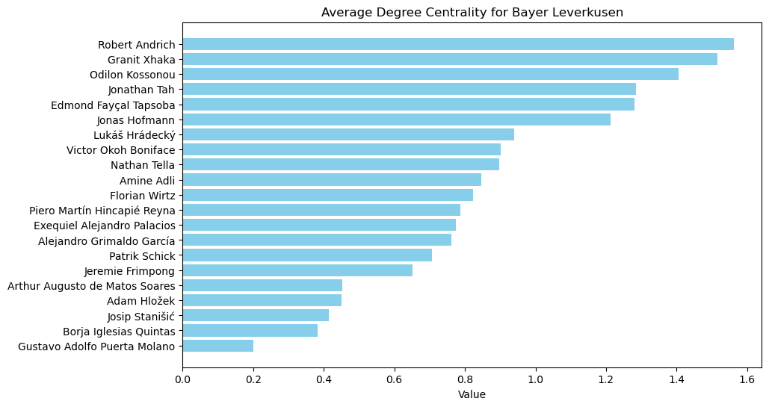
Players Central to Structure
Center-backs and Midfielders are most central to passing structure.
Granit Xhaka and Exequiel Alejandro Palacios: High number of completed passes.

Slide 9
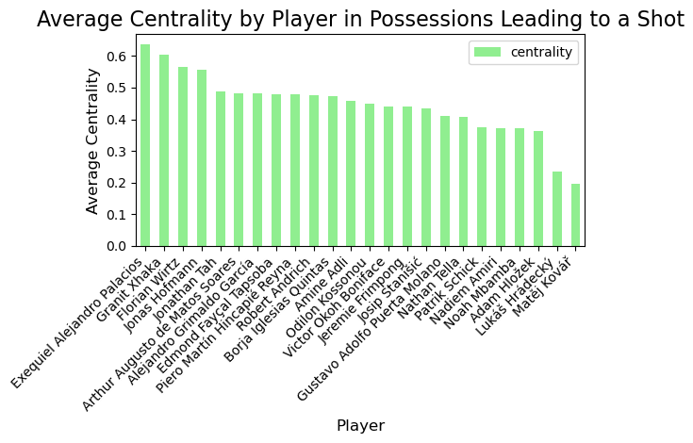
Players Central to Creating Shots
Analyzed only possession which lead to a shot.
Exequiel Alejandro Palacios, Granit Xhaka, and Florian Wirtz are most central to the passing structure.

Slide 10
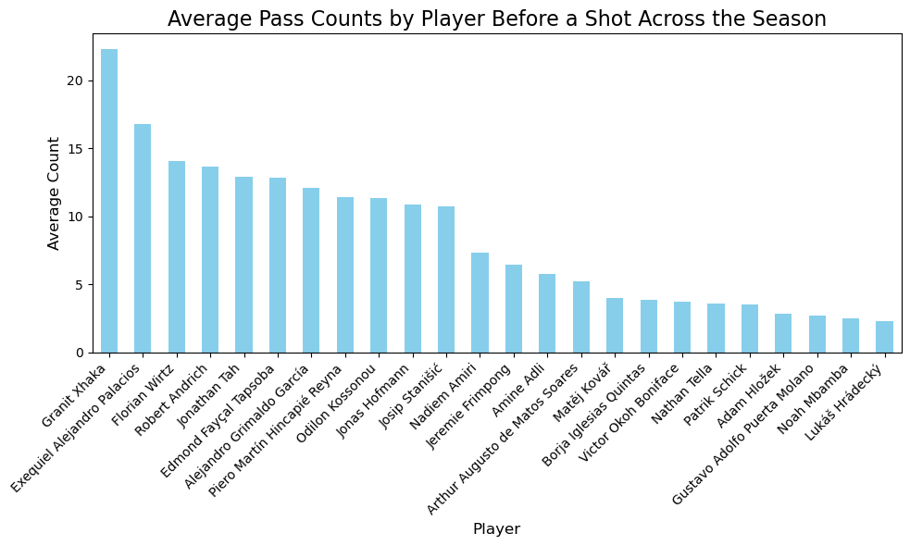
Players Central to Creating Shots
Analyzed only possession which lead to a shot.
Exequiel Alejandro Palacios, Granit Xhaka, and Florian Wirtz completed the most passes.

Slide 11
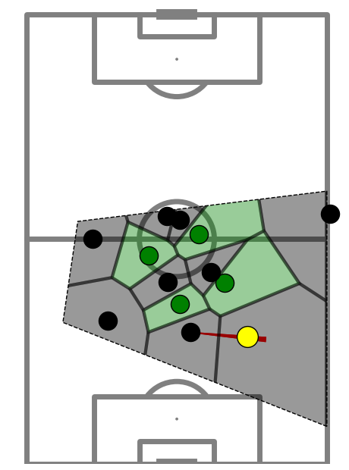
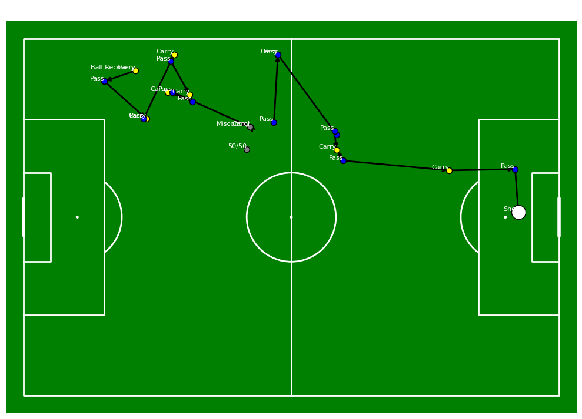
When is a player important to the passing structure?
Balance in play is preferred
Forward, down field passes → Low space, high goal potential
Passing sideways → more space, Low goal potential
Forward passes into space → Ideal goal scoring opportunities

Slide 12
When is a player important to the passing structure?
Balance in play is preferred
Forward, down field passes → Low space, closer to goal
Passing sideways → more space, Low goal potential
Forward passes into space → Ideal goal scoring opportunities

Slide 13
When is a player important to the passing structure?
Balance in play is preferred
Forward, down field passes → Low space, closer to goal
Passing backwards → more space, further from goal
Forward passes into space → Ideal goal scoring opportunities

Slide 14
When is a player important to the passing structure?
Balance in play is preferred
Forward, down field passes → Low space, closer to goal
Passing backwards → more space, further from goal
Forward passes into space → Ideal goal scoring opportunities

Slide 15
Identifying Key Players

Slide 16
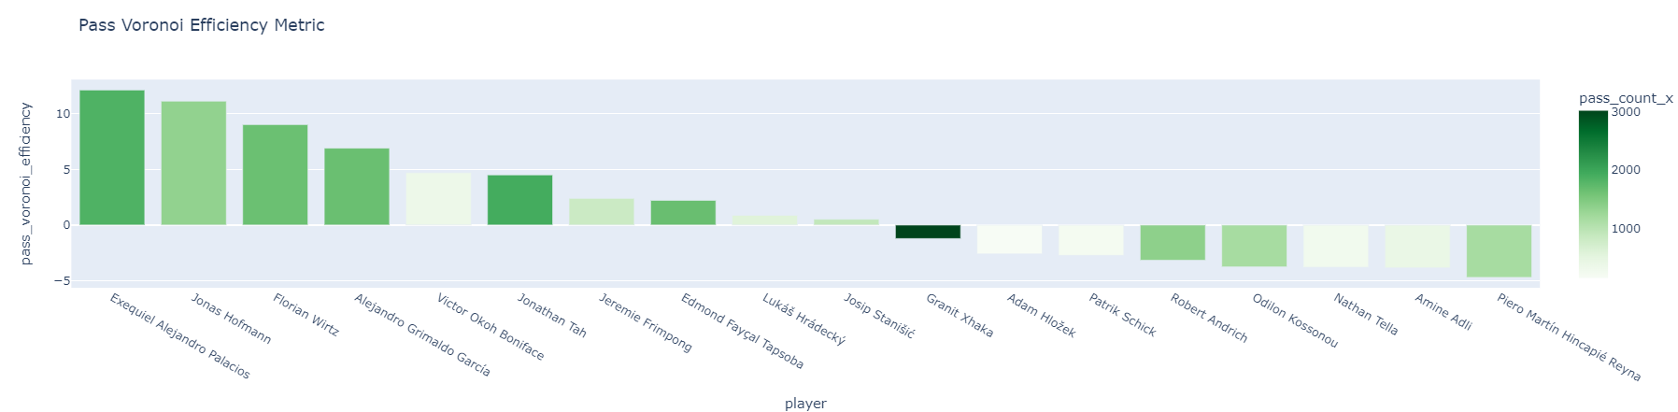
Identifying Key Players

Slide 17
Key Players
Exequiel Alejandro Palacio →
Best pass Voronoi efficiency.
Most central to possession which lead to a shot.
Granit Xhaka →
Prolific passer, most completed passes.
Central to passing structures which lead to goals.
Low pass Voronoi efficiency.
Florian Wirtz →
Key player in possession leading to shot.
High pass Voronoi efficiency.
Not as prolific a passer.

Slide 18
Limitations
Past performance doesn’t always predict future performance.
Due to data limitations, Bayer Leverkusen was the only team analyzed.
Player dribbles were not considered in the structure, leaving out the influence of certain players who are best at carrying the ball forward.
Taking lots of shots does not necessarily equal lots of goals. Some shots are better than others.

Slide 19
Future Work
Incorporate more advanced statistics in the pass Voronoi efficiency such as:
Expected goals
Expected threat
Pass difficulty
Analyze all teams across multiple leagues and seasons.

